Slide 1
Promoting Oral Health
through School Based Health Systems
Notes:
Esther

Slide 2
Objectives
Trends and current issues
Evidence-based practices/ strategies
State oral health programs
Guidance on school-based dental health systems
Notes:
Esther

Slide 3
What is the oral health status of children?
Notes:
Esther

Slide 4
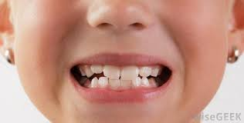
Trends in Oral Health Status
Children
Dental caries prevalence decreased and sealant prevalence increased
Dental caries in children’s permanent teeth declined from the early 1970s until mid 1990s
21% of children (6 to 11 y/o) have had dental caries in their permanent teeth.
8% of children (6 to 11 y/o) have untreated decay
Notes:
(NHANES 1988-1999, 1999-2002, 1999-2004)
Esther

Slide 5
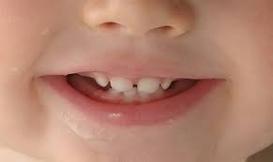
Trends in Oral Health Status
Children
Dental caries in primary teeth of children (2-11 y/o) declined from early 1970s until mid 1990s
42% of children (2 to 11 y/o) have had dental caries in their primary teeth
Notes:
(NHANES 1988-1999, 1999-2002, 1999-2004)
Esther

Slide 6
Children
For youngest children (2 to 5 y/o), dental caries in primary teeth increased (trend reversal)
Notes:
(NHANES 1988-1999, 1999-2002, 1999-2004)
Esther

Slide 7
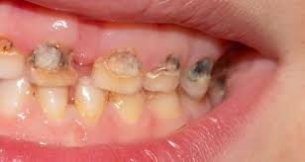
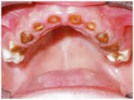
Early Childhood Caries (ECC)
ECC: presence of one or more decayed (non-cavitated or cavitated lesions), missing (due to caries) or filled tooth surfaces in any primary tooth in preschool-age child between birth and 71 months of age
Notes:
Esther

Slide 8
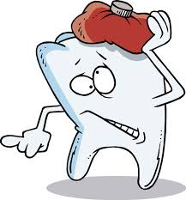
Consequences of ECC
Pain
Infection
Tooth loss
Impaired chewing and nutrition
Below average weight gain
Poor self esteem
Difficulty sleeping
School/work absences:
Increase caries in permanent dentition
Future dental work
Notes:
Esther

Slide 9
Children Visiting Emergency Departments and Ambulatory Surgery Facilities for Treatment of Early Childhood Caries in NYS, SPARCS 2004-2008, 2012-2014
Notes:
Esther

Slide 10
Early Childhood Caries (ECC)
23% of children 2-5 years of age have had caries experience
ECC is now reflective of most caries experience being treated
Notes:
http://www.biomedcentral.com/1472-6831/6/S1/S3#B5 2006 (study by Vargas and Ronzio)
(NHANES 1988-1994, 2011-2012)
Esther

Slide 11
Disparities
While the decrease in dental caries is significant in all population subgroups, significant disparities are still found in some population groups
Black and Hispanic children and those of lower income families have more severe decay
18% of white children 2-5 years of age have had caries experience vs 40% of Mexican-American children and 29% of black children have had caries experience
Notes:
(NHANES 1988-1999, 1999-2002, 1999-2004)
Esther

Slide 12
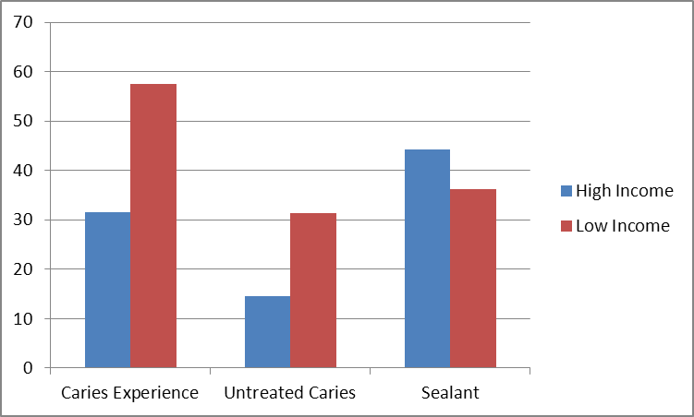
Disparities
NYS 3rd Grade Survey, 2009-2011
57.5
44.3
36.3
31.5
31.4
14.6
Notes:
Esther

Slide 13
Dental provider shortage
Low priority
Low fluoride exposure
What are some of the barriers to achieving optimal oral health?
Frequent and high intake of sugar
Cultural influences
Financial constraints
Notes:
Esther

Slide 14
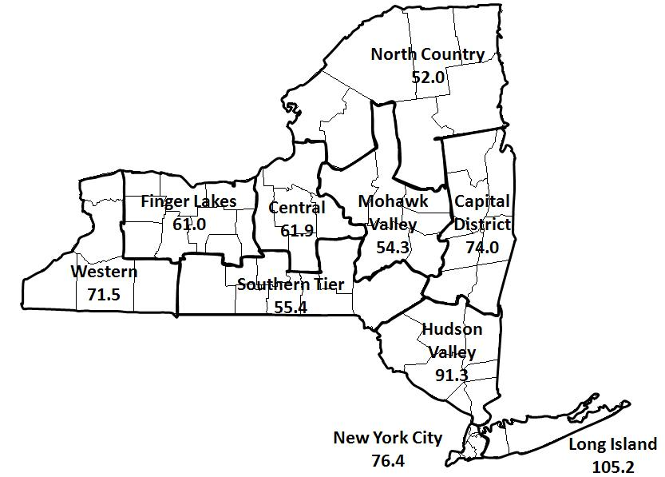
Workforce: Distribution of Dentists
New York: 79 dentists per 100,000 population
US: 55 dentists per 100,000 population
Strong variability across state
Range: 52.0 – 105.2
67.0 is underserved
Ratio vary further when examining specific populations
Medicaid Eligible
Low Income
Active Dentists per 100,000 Population By Region
Notes:
Esther

Slide 15
So, what can we do?
Notes:
Esther

Slide 16
2011 Institute of Medicine Reports
Advancing Oral Health in America
Focus on prevention (promote and monitor use of evidence-based preventive services in oral health and counseling across the life span)
Enhance delivery of oral health care
Improving Access to Oral Health Care for Vulnerable and Underserved Populations
Integrate oral health into overall health care
Improve dental education and training
Notes:
Esther

Slide 17
Evidence-Based Strategies/ Approaches
Mechanisms
Integration & coordination
Integrating oral health into primary care
Role of “non dental” providers in delivering oral health care
Non-traditional dental settings (i.e., schools)
Preventive Interventions
Fluoride
Dental sealants
Notes:
Esther

Slide 18
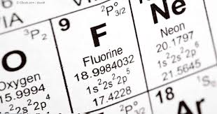
What is Fluoride?
Notes:
Esther

Slide 19
Recommendations on Fluoride
CDC, ADA, ASTDD
Use smear size fluoride toothpaste for toddlers (as soon as tooth erupts). Pea size for children 3-6 years.
Apply fluoride varnish as it is effective in preventing caries in both permanent and primary teeth
Target mouth rinsing to persons at high risk
Judiciously prescribe fluoride supplements
Continue and extend fluoridation of community drinking water
Notes:
Esther

Slide 20
Fluoride Varnish
Topical 5% sodium fluoride lacquer professionally applied to tooth surface
Resin matrix releases fluoride over 1 to 7 days (versus 10-15 min for gels/ foams)
Notes:
Esther

Slide 21
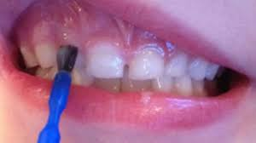
Fluoride Varnish
Helps prevent new cavities and halts cavities that have already started
Reductions in dental caries of 18-25% demonstrated when preventive care initiated before caries was observed
Notes:
Esther

Slide 22
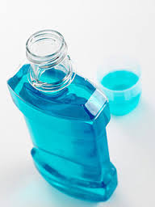
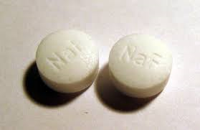
Fluoride Mouthrinse & Supplements
There is a benefit to using prescription-strength (0.09% fluoride) mouthrinse daily or weekly for caries prevention in permanent teeth among children aged 5-12 years
Dietary fluoride supplements should be intended for use among high-risk children between ages 6 mon-16 years living in non-fluoridated areas (0.6 ppm fluoride or less)
Notes:
(ADA Center for Evidence Based Dentistry)
(ASTDD Best Practices Report)
Esther

Slide 23
How do we deliver these different forms of fluoride to children?
Notes:
Kara

Slide 24
Supplemental Fluoride (Mouth Rinse) Program
MCHBG Funded ($120,000/year)
Targets children who do not have access to community water fluoridation, who have poor access to dental care, and who are living at or below the federal poverty level
160 schools/26,000 children
The program is under the general supervision of a dentist or physician from the community (who writes the fluoride prescription)
Parental consent is necessary in order to participate in the program
Participating children over the age of 6, use a weekly 5mL or 10mL of 0.2% sodium fluoride rinse solution
Notes:
Kara

Slide 25
Supplemental Fluoride (Mouth Rinse) Program
State Education Department’s (SED) Guidelines for Administration for Medication in School, April 2002: requires the rinse be
in original manufacturer packaging; pre-mixed and in unit dose
(the premixed, unit dose cups are essential to prevent students from receiving more than the required amount of fluoride, and prevents cross-contamination of salivary fluids during the rinse procedure)
in a clear, dye free formula which eliminates the risk of reaction for those with dye allergy participating in the program
Notes:
Dionne

Slide 26
What about… Sealants?
Notes:
Esther

Slide 27
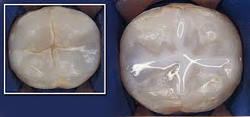
Sealants
Plastic material applied to the chewing surfaces of premolars and molars
Plastic resin bonds directly into the pits and fissures of the chewing surface acting as a barrier to protect enamel from plaque and acids
Notes:
Esther

Slide 28
Sealants
Best to apply sealants soon after teeth have erupted (6 years old – first molars; 12 years old – second molars)
Last 5 to 10 years, but should be checked at regular dental appointments
Do not replace fluorides, such as those used in fluoride varnish and community water supplies (keep germs and food particles out of the grooves)
Notes:
Esther

Slide 29
How do we deliver sealants to children?
Notes:
Kara

Slide 30
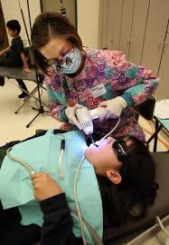
School Based Dental Sealant Programs
School systems provide a great opportunity for delivering sealants in the community
NYS Action Plan guides our work as an integral part of ensuring health throughout the life course
Community Preventive Services Task Force recommends school-based sealant delivery programs
Strong evidence of effectiveness in preventing dental caries (tooth decay) among children
Notes:
Kara

Slide 31
A School-Based Health Center Dental (SBHC-D) clinic is an Article 28 hospital or diagnostic and treatment center extension clinic that provides dental services in a school building
42% of children (2 to 11 years) have had dental caries (cavities) in their primary teeth!
Did you know?
There is a separate application process for new of existing SBHC’s that want to add dental services
Notes:
Kara

Slide 32
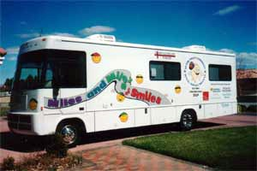
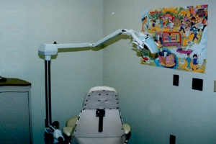
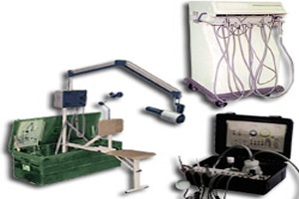
Models/Modes of Operation
SBHC-D programs, operated by NYS Department of Health licensed health care facilities known as “Article 28”, provide dental services (preventive and treatment) to students through portable equipment, mobile dental vans, or in-school dental offices.
Portable Equipment
Mobile Van
Fixed School Site
Notes:
Kara

Slide 33
NYS School Based Health Center Dental Program
MCHBG: $1.5 million/year (new cycle begins July 1, 2017)
Preventive dental services (some treatment)
Address disparities (lessen gap) target low-income urban/rural
Sealants, target second and third graders
53 sponsors
1,500 schools
300,000 children served
Notes:
Kara

Slide 34
Meeting Our State and National Goals
State Prevention Agenda
*Reduce the prevalence of dental caries among NYS children *Increase the percentage of State residents that receive optimally fluoridated drinking water
Healthy People 2020
*Oral Health: Persons aged 2 years and older who used the oral health care system in the past 12 months
NYS Title V Maternal and Child Health Services Block Grant State Action Plan (2016-2020) *Promote oral health and reduce tooth decay across the life course Increase the % of NYS residents served by community water systems with optimally fluoridated water; Reduce the prevalence of dental caries amount NYS children Increase the % of children and adolescents who had a preventive dental visit in the past year Increase the % of pregnant women who had a dental visit during pregnancy
Notes:
Dionne

Slide 35
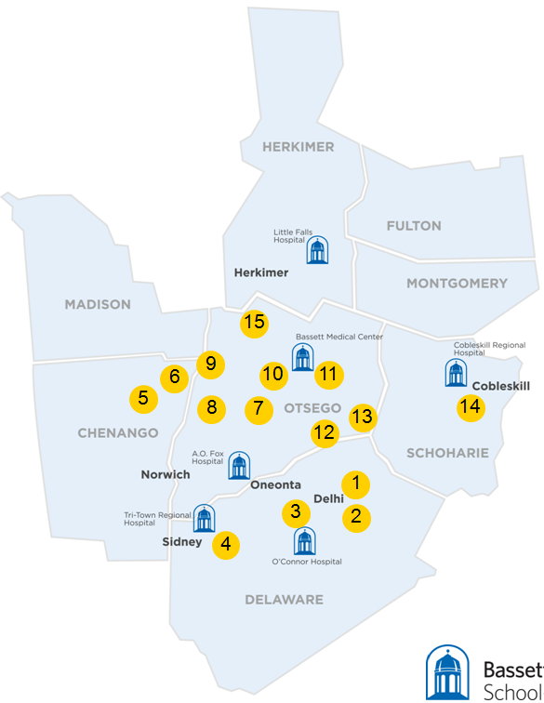
Bassett HealthCare Network
School-Based Health Centers
20 SBHCs
Over 30,000 annual visits
Comprehensive care to Pre-K through 12 graders
No out of pocket costs to families
October 21, 2016

Slide 36
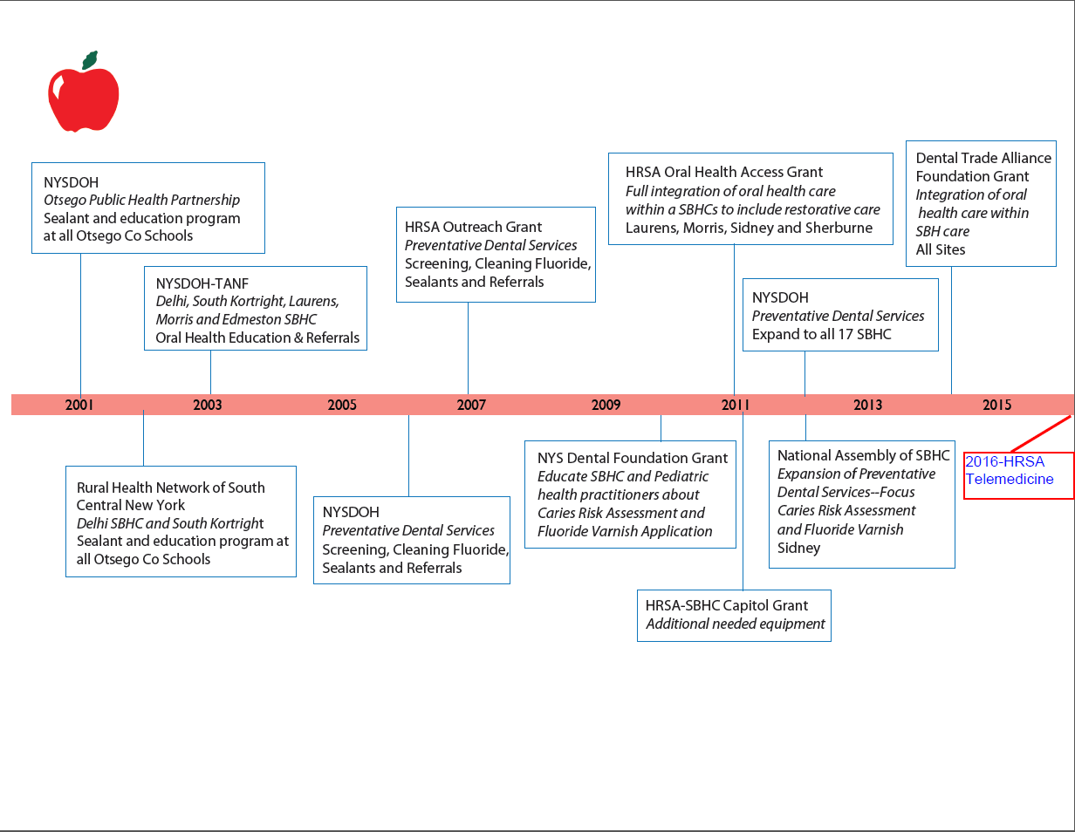
SBHC
Dental Timeline
October 21, 2016

Slide 37
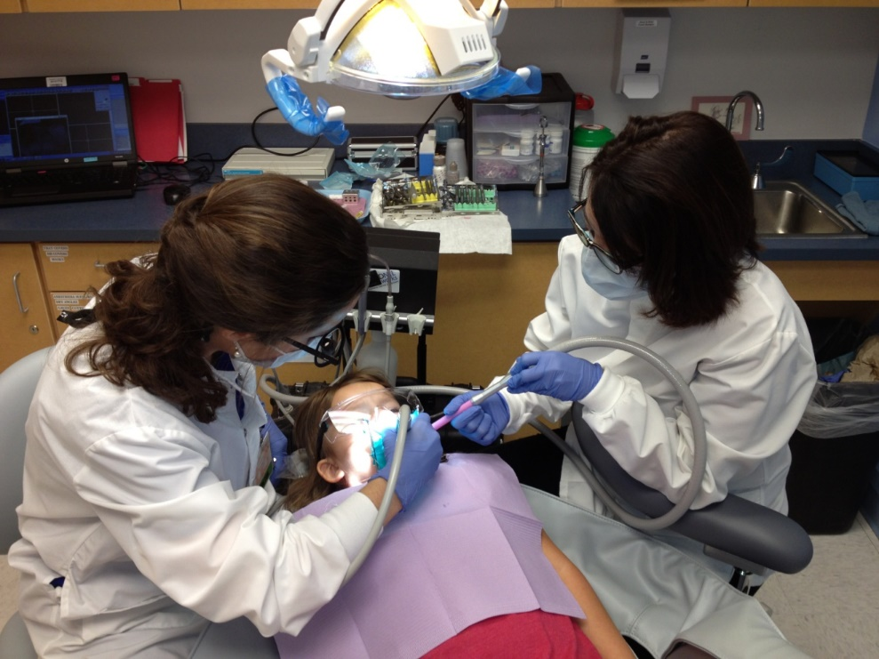
Clinical Considerations:
Equipment: Stationary or Portable?
Sterilization: On-Site or Off-Site?
Space: Adequate or not?
Procedures: Sedation? Referrals?
Availability: Acute Care? Parents?
October 21, 2016

Slide 38
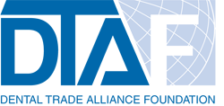
New York State Department of Health Children’s Oral Healthcare Access Project(HRSA) Dental Trade Alliance Foundation The Clark Foundation New York State Dental Foundation
Work supported by:
October 21, 2016

Slide 39
Questions?
Thank you!

